Slide 1
360
State Street
New Haven • CT • 06510
Structural | Sabrina Duk | T. Boothby

Slide 2
Presentation Overview
360
About 360 State Street
Thesis Objectives
Depth Study – Structural Design
Alternative Framing System: Staggered Trusses to Traditional Steel Framing
Breadth Study – Building Envelop Design
Precast, Aluminum, & Glass Façade to All Glass Façade
Breadth Study – Cost & Schedule Comparison
Viability of Proposed Framing Systems & Alternative Façade
Conclusions
Acknowledgements
State Street
New Haven • CT • 06510
Structural | Sabrina Duk | T. Boothby
Structural | Sabrina Duk | T. Boothby

Slide 3
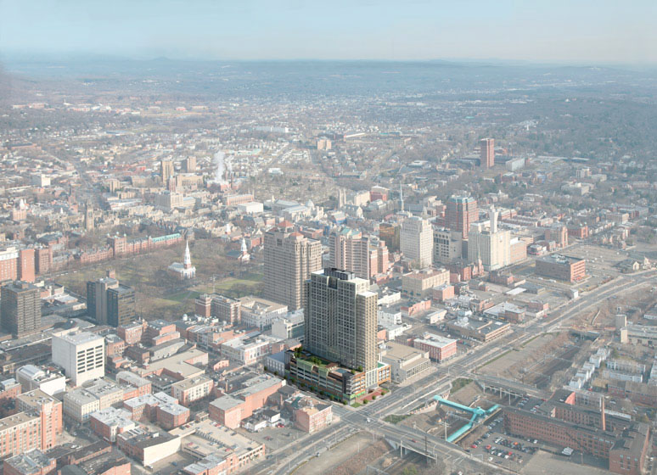
About 360 State Street
Presentation Overview
About 360 State Street
Thesis Objectives
Depth Study – Structural Design
Alternative Framing System: Staggered Trusses to Traditional Steel Framing
Breadth Study – Building Envelop Design
Precast, Aluminum, & Glass Façade to All Glass Façade
Breadth Study – Cost & Schedule Comparison
Viability of Proposed Framing Systems & Alternative Façade
Conclusions
Acknowledgements
Project Team
Owner/Architect: Becker + Becker Associates
Structural Engineer: DeSimone Consulting Engineers
General Contractor: Suffolk Construction
Building Information
Location: New Haven, Connecticut
Size: 700,000 gsf ( 32 Stories)
Development Cost: $180 million
Construction: Sept 2008 – Oct 2010
Structural | Sabrina Duk | T. Boothby

Slide 4
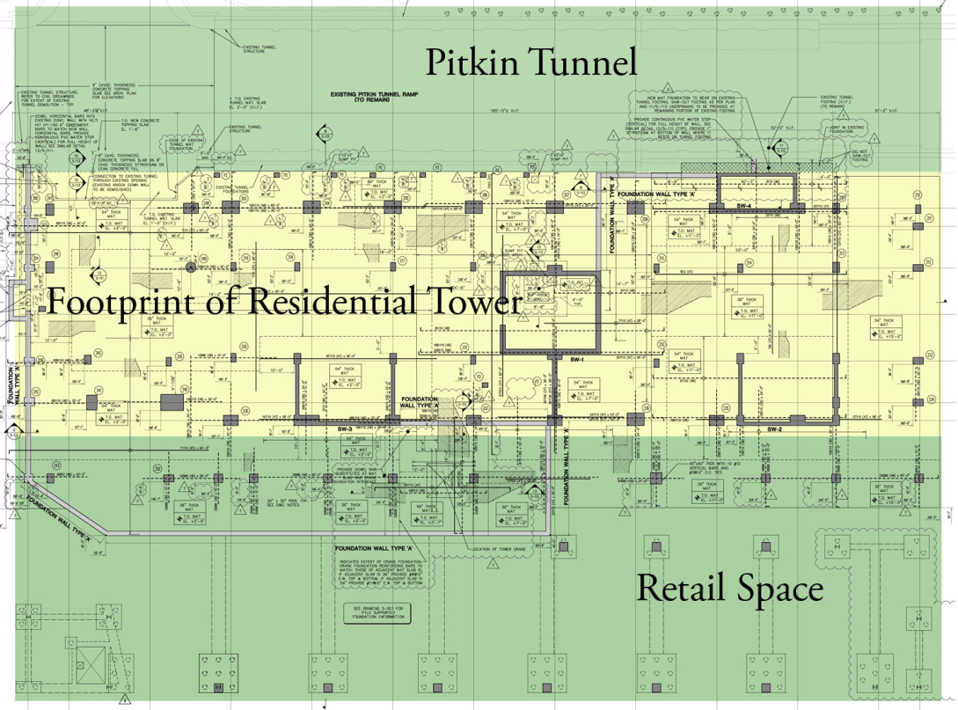
About 360 State Street
Presentation Overview
Architecture
2 Retail Units, 500 Parking Spaces, 500 Apartment Units + Amenities
Precast Concrete & Aluminum Panel Façade with Glazing, Ornamentation
Rooftop Gardened Terrace
Outdoor Pool & Patio
Sustainable Features
LEED Platinum Certification
Local & Recycled Building Materials
400kW Fuel Cell
Geothermal Walls, High Performance Windows, & Elevators that Recapture their own Energy
About 360 State Street
Thesis Objectives
Depth Study – Structural Design
Alternative Framing System: Staggered Trusses to Traditional Steel Framing
Breadth Study – Building Envelop Design
Precast, Aluminum, & Glass Façade to All Glass Façade
Breadth Study – Cost & Schedule Comparison
Viability of Proposed Framing Systems & Alternative Façade
Conclusions
Acknowledgements
Structural | Sabrina Duk | T. Boothby

Slide 5
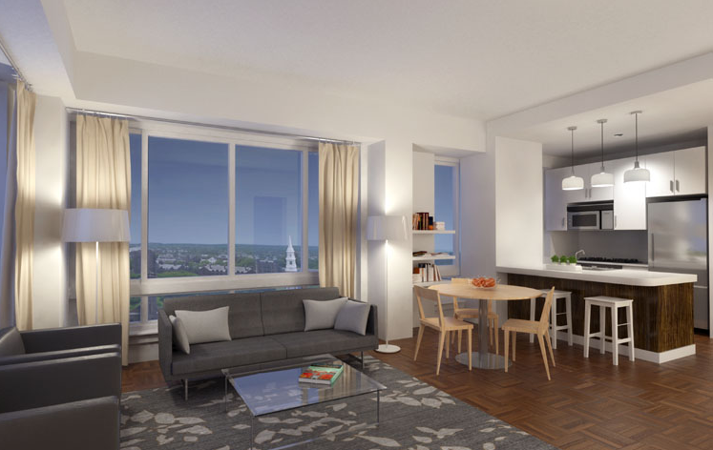
About 360 State Street
Presentation Overview
Architecture
2 Retail Units, 500 Parking Spaces, 500 Apartment Units + Amenities
Precast Concrete & Aluminum Panel Façade with Glazing, Ornamentation
Rooftop Gardened Terrace
Outdoor Pool & Patio
Sustainable Features
LEED Platinum Certification
Local & Recycled Building Materials
400kW Fuel Cell
Geothermal Walls, High Performance Windows, & Elevators that Recapture their own Energy
About 360 State Street
Thesis Objectives
Depth Study – Structural Design
Alternative Framing System: Staggered Trusses to Traditional Steel Framing
Breadth Study – Building Envelop Design
Precast, Aluminum, & Glass Façade to All Glass Façade
Breadth Study – Cost & Schedule Comparison
Viability of Proposed Framing Systems & Alternative Façade
Conclusions
Acknowledgements
Structural | Sabrina Duk | T. Boothby

Slide 6
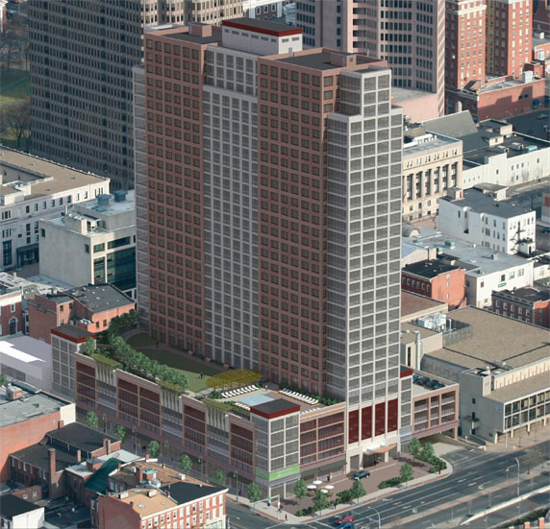
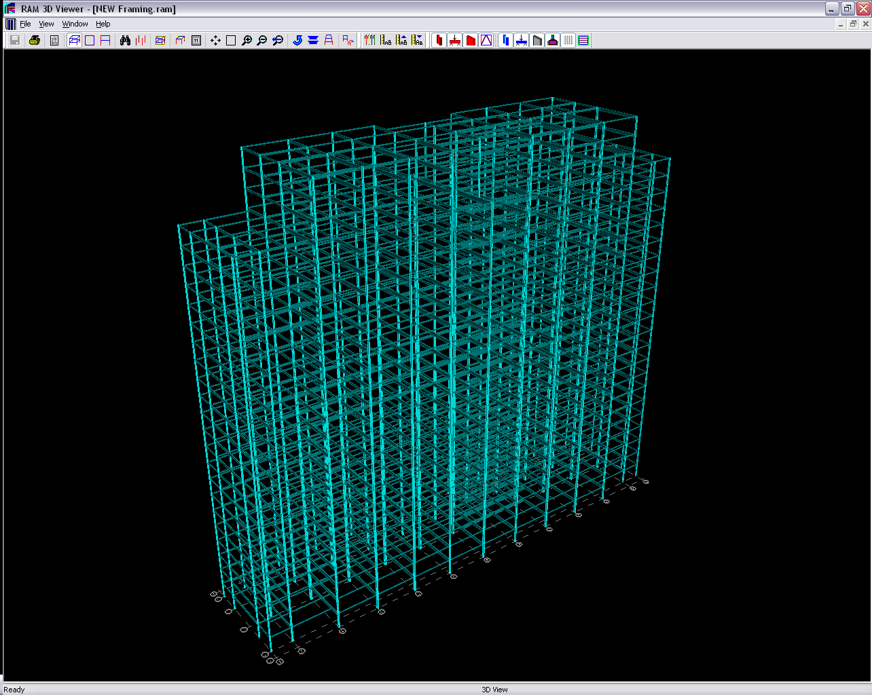
Thesis Objectives
Presentation Overview
Structural Depth
Originally Designed as Cast-In-Place Concrete Structure
Contractors Not Able to Provide Competitive Cost & Schedule
New York vs. New Haven
Redesigned to Staggered Steel Trusses in 8 Weeks
Proposal: Design Alternative Framing for Gravity & Lateral Systems
About 360 State Street
Thesis Objectives
Depth Study – Structural Design
Alternative Framing System: Staggered Trusses to Traditional Steel Framing
Breadth Study – Building Envelop Design
Precast, Aluminum, & Glass Façade to All Glass Façade
Breadth Study – Cost & Schedule Comparison
Viability of Proposed Framing Systems & Alternative Façade
Conclusions
Acknowledgements
Overall Project Goals
Longevity & Durability of Structure
Viable Alternative Solutions
Conscious, Sustainable Design Decisions
Maintain Architectural Floor Plans
Focus on Upper (26) Stories
Structural | Sabrina Duk | T. Boothby

Slide 7
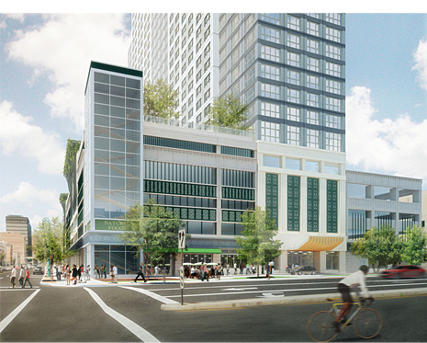
Thesis Objectives
Presentation Overview
Breadth #1
Building Envelop Study
Proposal: Alternative Glass Façade
High Performance
Breadth #2
Cost & Schedule Analysis
Proposal: Compare Viability of Designs
Viability of Designs
About 360 State Street
Thesis Objectives
Depth Study – Structural Design
Alternative Framing System: Staggered Trusses to Traditional Steel Framing
Breadth Study – Building Envelop Design
Precast, Aluminum, & Glass Façade to All Glass Façade
Breadth Study – Cost & Schedule Comparison
Viability of Proposed Framing Systems & Alternative Façade
Conclusions
Acknowledgements
Overall Project Goals
Longevity & Durability of Structure
Viable Alternative Solutions
Conscious, Sustainable Design Decisions
Maintain Architectural Floor Plans
Focus on Upper (26) Stories
Structural | Sabrina Duk | T. Boothby

Slide 8
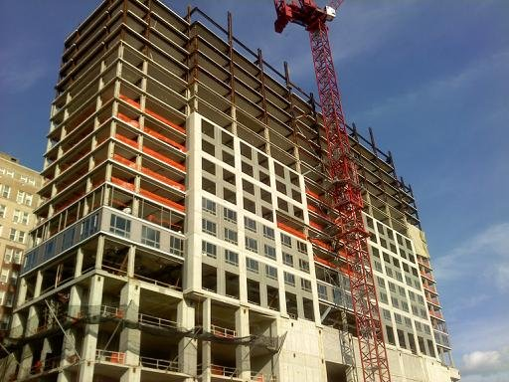
Depth Study
Presentation Overview
Structural Design
An Alternative Framing Solution
Provide a Preliminary Design for the Gravity & Lateral Systems using a more Traditional Steel Framing System
Compare Existing & Proposed Systems to Determine the Ideal Solution
Structural Design Goals
Increase Strength & Rigidity with additional Structural Elements
Minimize Floor Depth by Shortening Span Lengths
Decrease Overall Building Weight
Optimize Lateral System & Foundation
About 360 State Street
Thesis Objectives
Depth Study – Structural Design
Alternative Framing System: Staggered Trusses to Traditional Steel Framing
Breadth Study – Building Envelop Design
Precast, Aluminum, & Glass Façade to All Glass Façade
Breadth Study – Cost & Schedule Comparison
Viability of Proposed Framing Systems & Alternative Façade
Conclusions
Acknowledgements
Structural | Sabrina Duk | T. Boothby

Slide 9
Presentation Overview
Existing Gravity System
About 360 State Street
Thesis Objectives
Depth Study – Structural Design
Alternative Framing System: Staggered Trusses to Traditional Steel Framing
Breadth Study – Building Envelop Design
Precast, Aluminum, & Glass Façade to All Glass Façade
Breadth Study – Cost & Schedule Comparison
Viability of Proposed Framing Systems & Alternative Façade
Conclusions
Acknowledgements
Typical Residential Floor Plan
(9) Staggered Steel Truss Frames @ 23’ – 8” o.c.
W12x53 Spandrel Beams + Floor Opening Framing
8” Hollow Core Plank Floor System w/ Topping
Typical Truss Framing
Exterior Columns: W14x120 thru W14x505 – Splices also Staggered
Typical W10x Top & Bottom Chords - HSS Diagonals
Vierendeel Panel for Corridor Opening
Structural | Sabrina Duk | T. Boothby

Slide 10
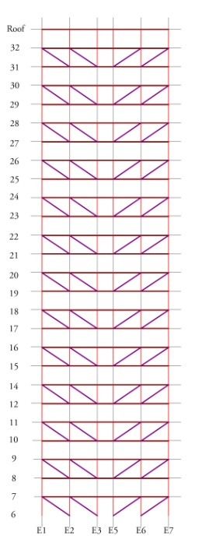
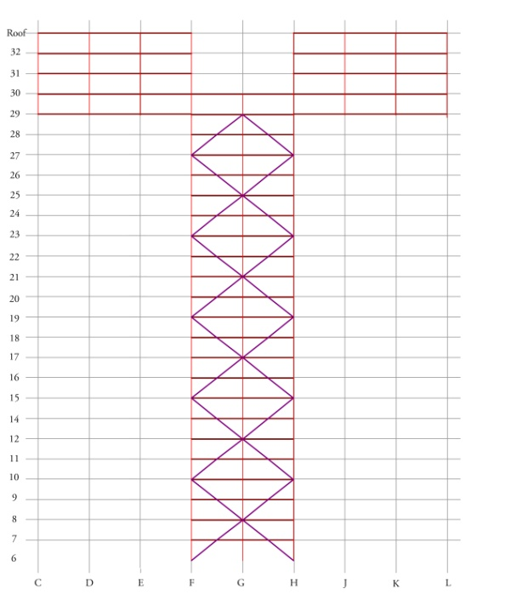
Presentation Overview
Existing Lateral System
About 360 State Street
Thesis Objectives
Depth Study – Structural Design
Alternative Framing System: Staggered Trusses to Traditional Steel Framing
Breadth Study – Building Envelop Design
Precast, Aluminum, & Glass Façade to All Glass Façade
Breadth Study – Cost & Schedule Comparison
Viability of Proposed Framing Systems & Alternative Façade
Conclusions
Acknowledgements
(9) Staggered Steel Truss Frames @ 23’ – 8” o.c.
(2) X – brace Frames w/ 5 –Story Moment Frame (120 Connections)
8” Hollow Core Plank as Rigid Diaphragm
Center of Mass is Slightly off from Center of Rigidity
Structural | Sabrina Duk | T. Boothby

Slide 11
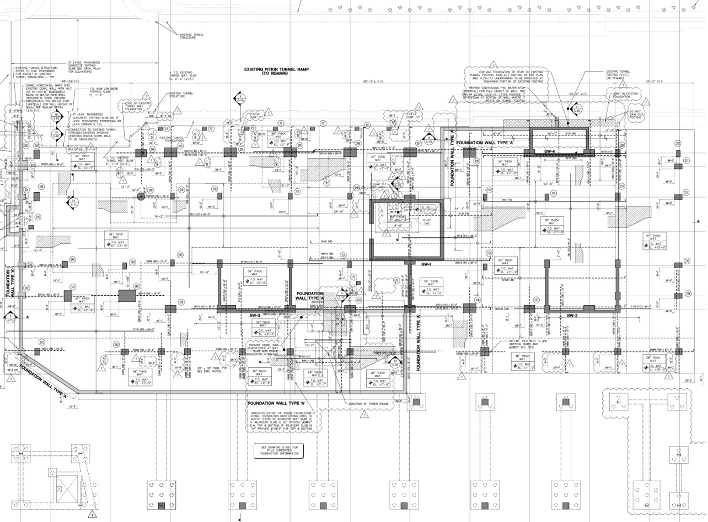
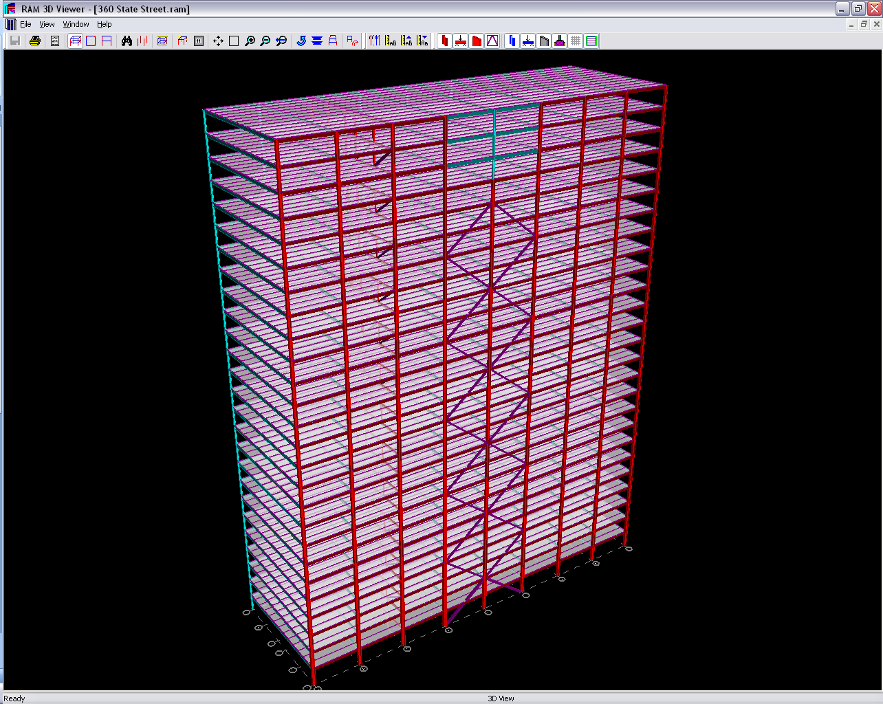
Presentation Overview
Existing Framing Systems
About 360 State Street
Thesis Objectives
Depth Study – Structural Design
Alternative Framing System: Staggered Trusses to Traditional Steel Framing
Breadth Study – Building Envelop Design
Precast, Aluminum, & Glass Façade to All Glass Façade
Breadth Study – Cost & Schedule Comparison
Viability of Proposed Framing Systems & Alternative Façade
Conclusions
Acknowledgements
36” to 68” Mat Slab Foundation w/ 8,000 psi Concrete
4.5 TSF Bearing Capacity
Bear onto Concrete Columns
Gravity Loads 2.81 TSF Bearing
Overall Building Weight: 90, 757 kips
3244 Structural Members
Structural | Sabrina Duk | T. Boothby

Slide 12
Design Considerations
Presentation Overview
Foundation Columns Locations for Bearing
Geometry Residential Tower 62’ x 260’
Steel Column Orientation
About 360 State Street
Thesis Objectives
Depth Study – Structural Design
Alternative Framing System: Staggered Trusses to Traditional Steel Framing
Breadth Study – Building Envelop Design
Precast, Aluminum, & Glass Façade to All Glass Façade
Breadth Study – Cost & Schedule Comparison
Viability of Proposed Framing Systems & Alternative Façade
Conclusions
Acknowledgements
Structural | Sabrina Duk | T. Boothby

Slide 13
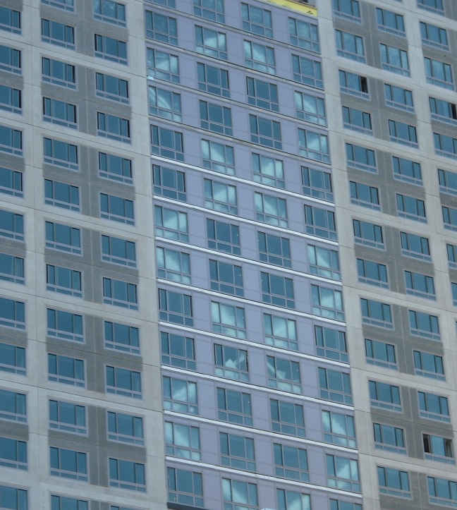
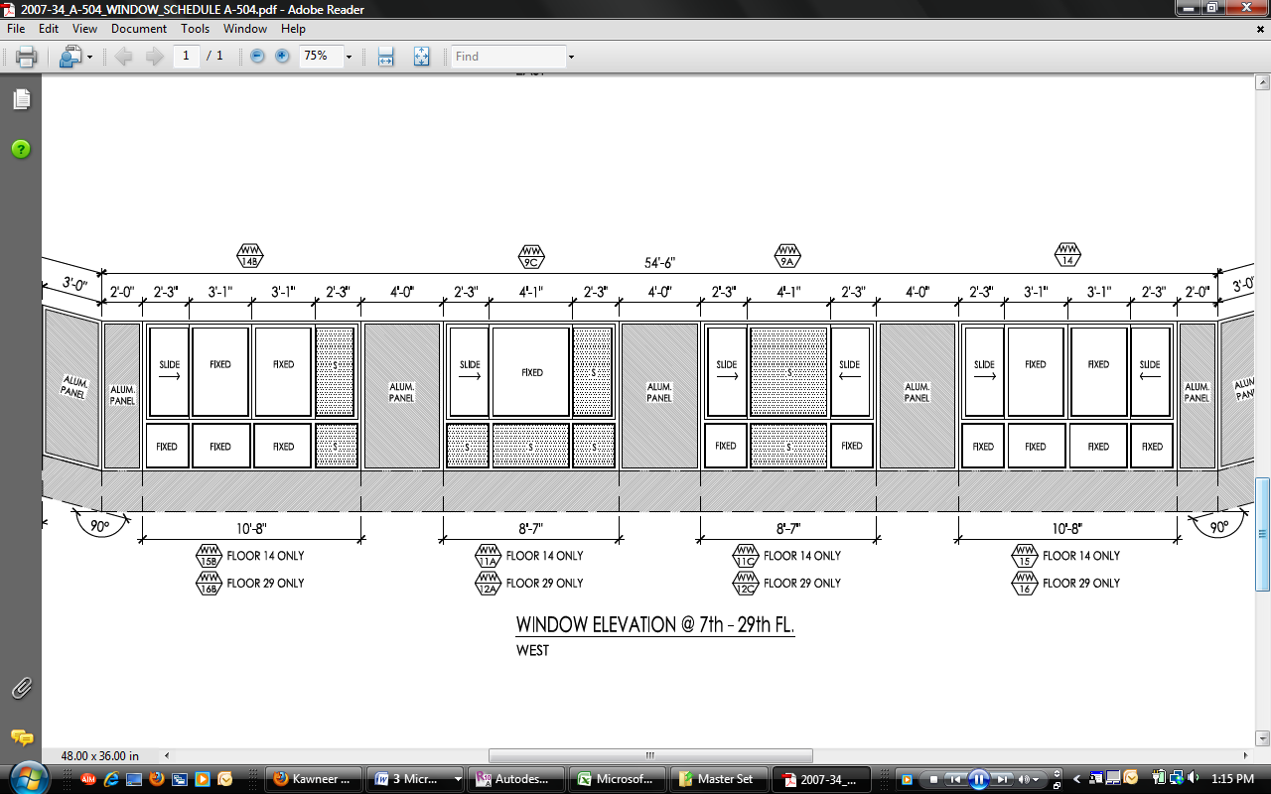
Design Considerations
Presentation Overview
About 360 State Street
Thesis Objectives
Depth Study – Structural Design
Alternative Framing System: Staggered Trusses to Traditional Steel Framing
Breadth Study – Building Envelop Design
Precast, Aluminum, & Glass Façade to All Glass Façade
Breadth Study – Cost & Schedule Comparison
Viability of Proposed Framing Systems & Alternative Façade
Conclusions
Acknowledgements
Gridlines
Façade Placement on East/West Face
Interior Wall Locations
Window Obstructions
Interference w/ Façade Aesthetic
Note:
Only Changing Framing
Maintaining HCP Floor System
Structural | Sabrina Duk | T. Boothby

Slide 14
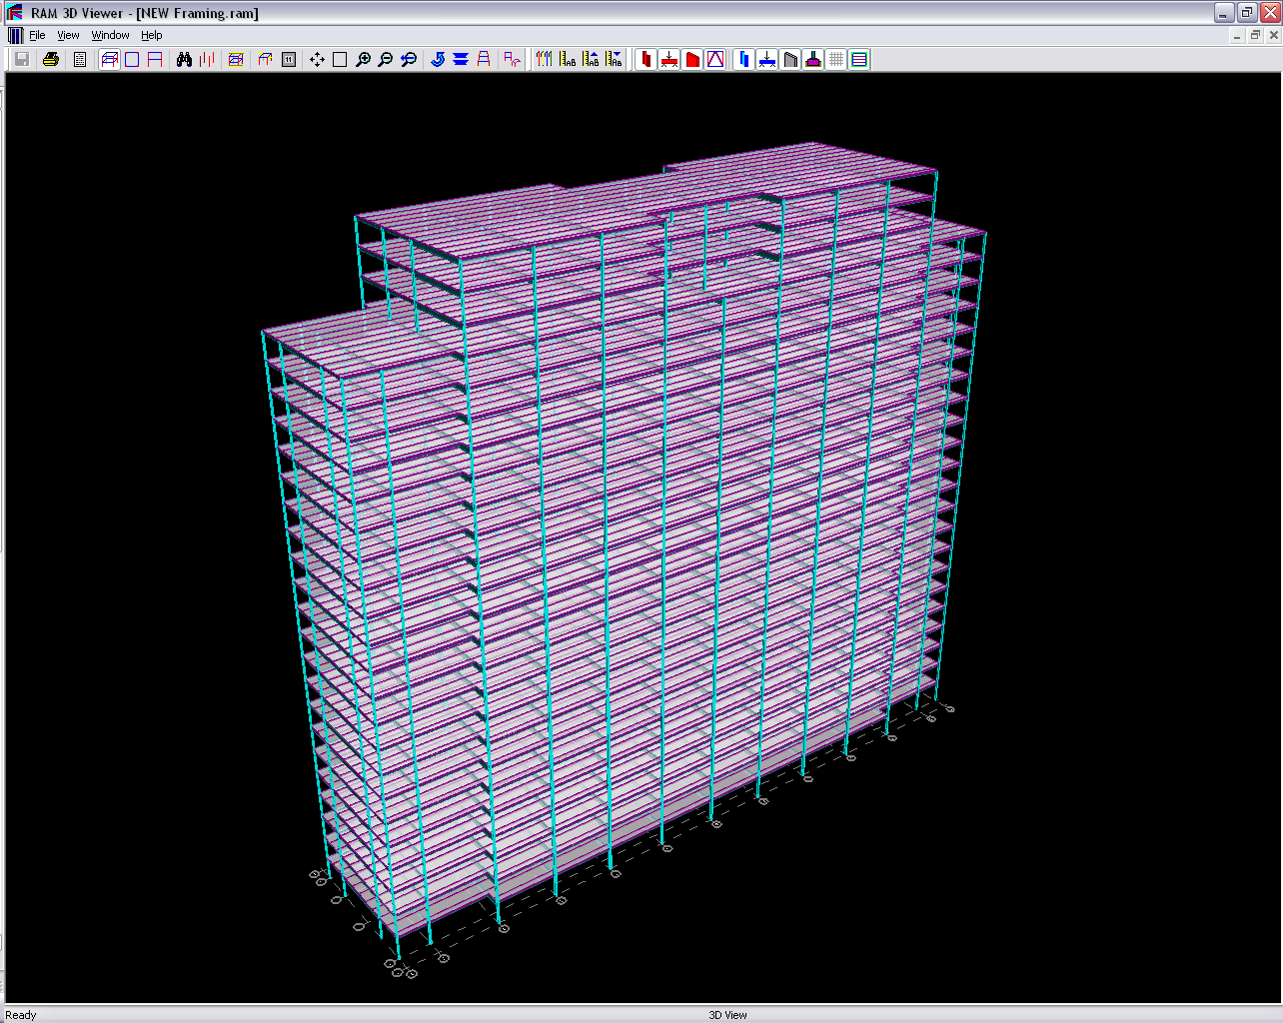
Presentation Overview
Proposed Gravity System
About 360 State Street
Thesis Objectives
Depth Study – Structural Design
Alternative Framing System: Staggered Trusses to Traditional Steel Framing
Breadth Study – Building Envelop Design
Precast, Aluminum, & Glass Façade to All Glass Façade
Breadth Study – Cost & Schedule Comparison
Viability of Proposed Framing Systems & Alternative Façade
Conclusions
Acknowledgements
Typical Residential Floor Plan
(4) Rows of Columns – W10x33 thru W10x68
Maintained 23’ – 8” Spacing due to Apartment Units
Beams – W8x10 thru W24x55 Deflections: l/360 ≥ 1.0”
Structural | Sabrina Duk | T. Boothby

Slide 15
Presentation Overview
Proposed Lateral System
About 360 State Street
Thesis Objectives
Depth Study – Structural Design
Alternative Framing System: Staggered Trusses to Traditional Steel Framing
Breadth Study – Building Envelop Design
Precast, Aluminum, & Glass Façade to All Glass Façade
Breadth Study – Cost & Schedule Comparison
Viability of Proposed Framing Systems & Alternative Façade
Conclusions
Acknowledgements
Typical Residential Floor Plan
Critical Column – W14x43 thru W14x176
(3) Frames w/ Diagonal Braces – HSS10x10 & HSS8x8
Moment Frame – W16x31 Beams, 192 Connections
(1) X – Brace Frame – HSS14x14 & HSS10x10
Structural | Sabrina Duk | T. Boothby

Slide 16
Presentation Overview
Proposed Lateral System
About 360 State Street
Thesis Objectives
Depth Study – Structural Design
Alternative Framing System: Staggered Trusses to Traditional Steel Framing
Breadth Study – Building Envelop Design
Precast, Aluminum, & Glass Façade to All Glass Façade
Breadth Study – Cost & Schedule Comparison
Viability of Proposed Framing Systems & Alternative Façade
Conclusions
Acknowledgements
Typical Residential Floor Plan
Critical Column – W14x43 thru W14x176
(3) Frames w/ Diagonal Braces – HSS10x10 & HSS8x8
Moment Frame – W16x31 Beams, 192 Connections
(1) X – Brace Frame – HSS14x14 & HSS10x10
Structural | Sabrina Duk | T. Boothby

Slide 17
Presentation Overview
Proposed Framing Systems
About 360 State Street
Thesis Objectives
Depth Study – Structural Design
Alternative Framing System: Staggered Trusses to Traditional Steel Framing
Breadth Study – Building Envelop Design
Precast, Aluminum, & Glass Façade to All Glass Façade
Breadth Study – Cost & Schedule Comparison
Viability of Proposed Framing Systems & Alternative Façade
Conclusions
Acknowledgements
36” to 68” Mat Slab Foundation w/ 8,000 psi Concrete
4.5 TSF Bearing Capacity
Bear onto Concrete Columns
Gravity Loads 2.80 TSF Bearing
Overall Building Weight: 90, 288 kips
3787Structural Members
Structural | Sabrina Duk | T. Boothby

Slide 18
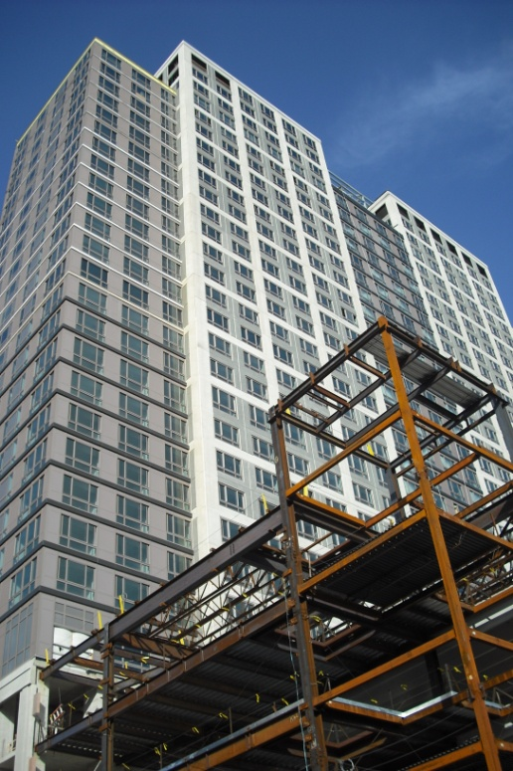
Breadth Study
Presentation Overview
Proposed Façade
1600 Wall System 3 from Kawneer
Prefabricated Curtain Wall
6” deep Aluminum Mullions w/
IsoStrut Thermal Break
1” Glass – Tempered & Spandrel
Building Envelop Design
Provide Alternative Façade to Typical Glass & Masonry
Increase Efficient Thermal Performance
Existing Façade
Precast Architectural Panels & Aluminum Panels + Chicago Style Windows
1” Tempered Glass, Low Emittance
About 360 State Street
Thesis Objectives
Depth Study – Structural Design
Alternative Framing System: Staggered Trusses to Traditional Steel Framing
Breadth Study – Building Envelop Design
Precast, Aluminum, & Glass Façade to All Glass Façade
Breadth Study – Cost & Schedule Comparison
Viability of Proposed Framing Systems & Alternative Façade
Conclusions
Acknowledgements
Description | Overall U - Value | Heat Loss (BTU/hr) | Heat Loss (Watt/hr) | Cost per year for one typical apartment unit
Existing | 0.12 | 1350 | 396 | $611.92
Proposed | 0.07 | 811 | 238 | $367.77
Structural | Sabrina Duk | T. Boothby

Slide 19
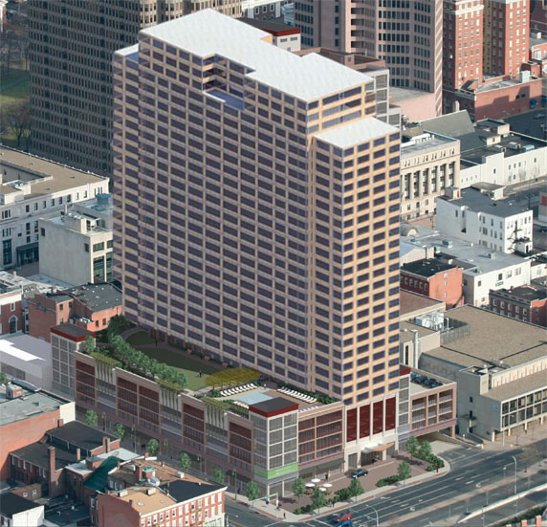
Breadth Study
Presentation Overview
Building Envelop Design
Provide Alternative Façade to Typical Glass & Masonry
Increase Efficient Thermal Performance
About 360 State Street
Thesis Objectives
Depth Study – Structural Design
Alternative Framing System: Staggered Trusses to Traditional Steel Framing
Breadth Study – Building Envelop Design
Precast, Aluminum, & Glass Façade to All Glass Façade
Breadth Study – Cost & Schedule Comparison
Viability of Proposed Framing Systems & Alternative Façade
Conclusions
Acknowledgements
Existing
Proposed
Structural | Sabrina Duk | T. Boothby
Existing
Proposed

Slide 20
Breadth Study
Presentation Overview
Description | Material O &P | Labor O & P | Equipment O &P | Total O &P | Overall Total
Staggered Trusses | $35.39 | $ 6.24 | $3.21 | $ 44.84 | $2,285,091.24
8” Hollow Core Planks | $14.60 | $2.01 | $0.65 | $17.26 | $7,234,011.20
Aluminum & Glazing | $68.48 | $12.13 | $ - | $80.61 | $12,718,645.80
Traditional Steel | $35.39 | $6.24 | $3.21 | $ 44.84 | $2,604,912.54
Spandrel Glass | $22.28 | $7.97 | $ - | $ 30.25 | $2,863,707.00
Tempered Glass | $10.33 | $2.00 | $ - | $ 12.33 | $778,170.96
Cost & Schedule Comparison
Compare Existing & Proposed Systems
Determine Viability of Structural Design
About 360 State Street
Thesis Objectives
Depth Study – Structural Design
Alternative Framing System: Staggered Trusses to Traditional Steel Framing
Breadth Study – Building Envelop Design
Precast, Aluminum, & Glass Façade to All Glass Façade
Breadth Study – Cost & Schedule Comparison
Viability of Proposed Framing Systems & Alternative Façade
Conclusions
Acknowledgements
Description | Framing | Installation | Façade | Installation
Existing | $9,519,102.44 | 102 days | $ 12,718,645.80 | Variable
Proposed | $9,838,923.74 | 116 days | $3,641,877.96 | Variable
Structural | Sabrina Duk | T. Boothby

Slide 21
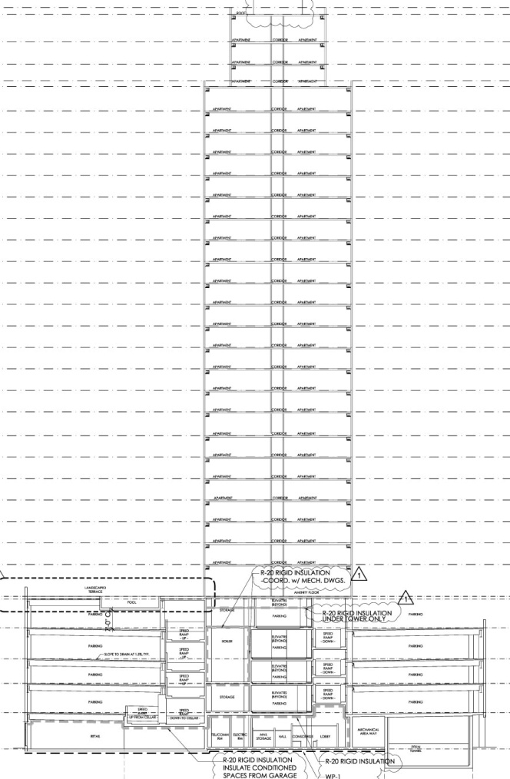
Breadth Study
Presentation Overview
Phase 1
Cost & Schedule Comparison
About 360 State Street
Thesis Objectives
Depth Study – Structural Design
Alternative Framing System: Staggered Trusses to Traditional Steel Framing
Breadth Study – Building Envelop Design
Precast, Aluminum, & Glass Façade to All Glass Façade
Breadth Study – Cost & Schedule Comparison
Viability of Proposed Framing Systems & Alternative Façade
Conclusions
Acknowledgements
Phase 2a
Phase 2b
Structural | Sabrina Duk | T. Boothby

Slide 22
Presentation Overview
Conclusions
Story Drift
Δ_{allowable} = 7.33”
Wind X = 5.50”
Wind Y = 1.50”
Δ_{allowable} y 40.64”
Seismic X = 26.71”
Seismic Y = 10.93”
Were Structural Design Goals Achieved?
Increase Strength & Rigidity with additional Structural Elements
Decrease Overall Building Weight
Optimize Lateral System & Foundation
About 360 State Street
Thesis Objectives
Depth Study – Structural Design
Alternative Framing System: Staggered Trusses to Traditional Steel Framing
Breadth Study – Building Envelop Design
Precast, Aluminum, & Glass Façade to All Glass Façade
Breadth Study – Cost & Schedule Comparison
Viability of Proposed Framing Systems & Alternative Façade
Conclusions
Acknowledgements
 | Existing | Proposed
Building Weight | 90,757 kips | 90,288 kips
# of Structural Members | 3,244 | 3,787
Gravity Loads | Pass | Pass
Lateral Loads | Pass | Pass
X Direction
Structural | Sabrina Duk | T. Boothby
Y Direction

Slide 23
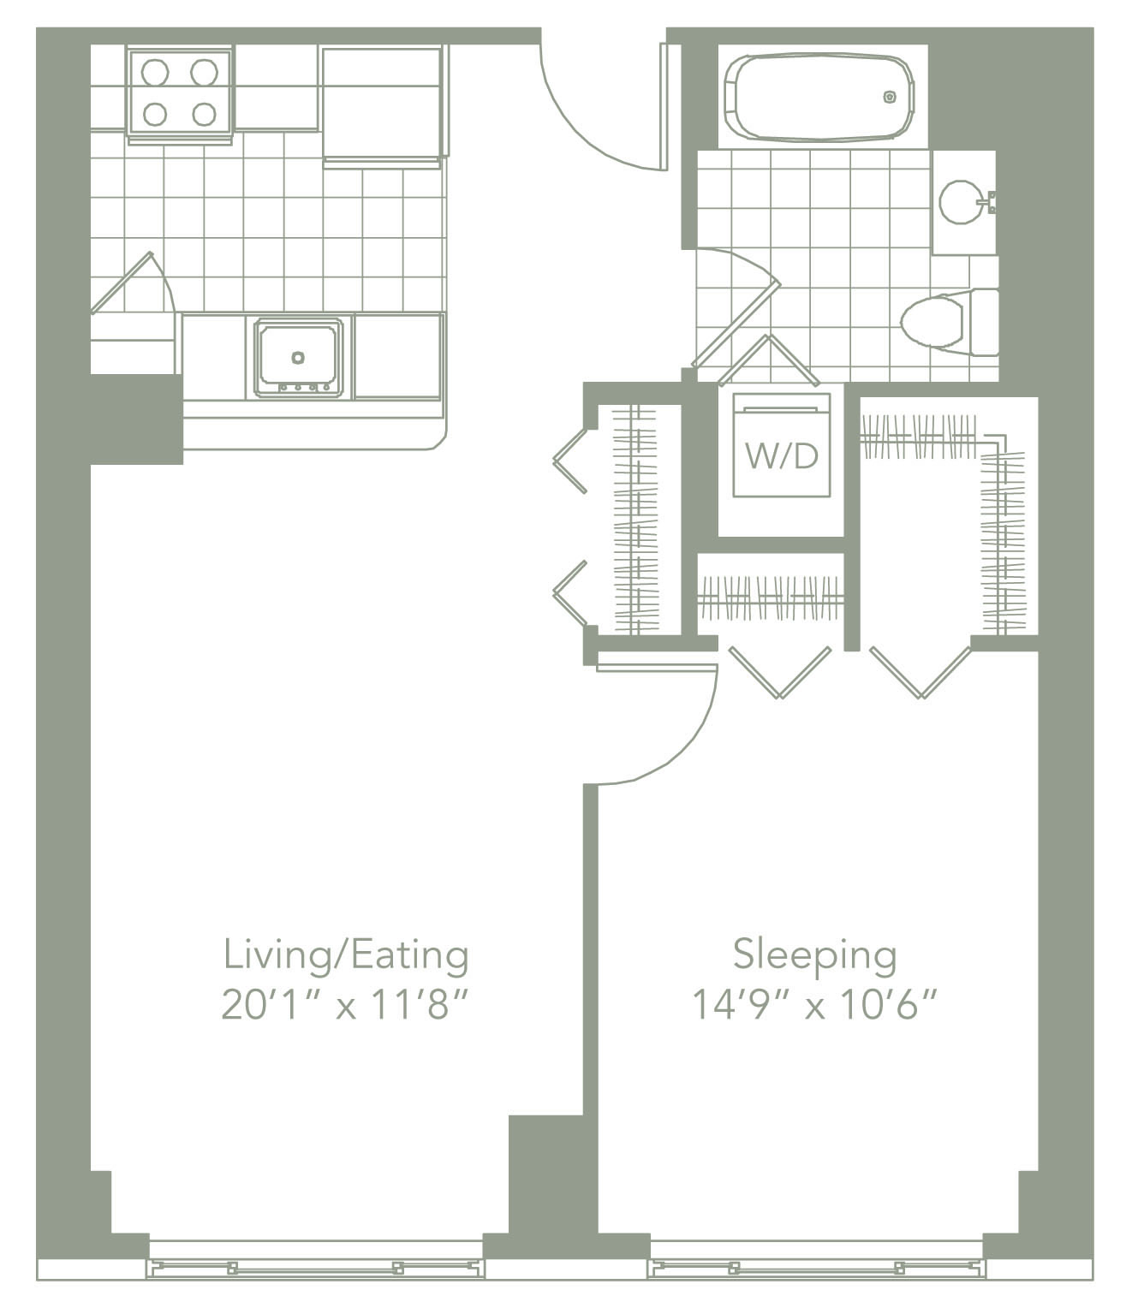
Presentation Overview
Conclusions
Were Structural Design Goals Achieved?
Minimize Negative Impact on Original Architectural Layout
Minimize Floor Depth by Shortening Span Lengths
About 360 State Street
Thesis Objectives
Depth Study – Structural Design
Alternative Framing System: Staggered Trusses to Traditional Steel Framing
Breadth Study – Building Envelop Design
Precast, Aluminum, & Glass Façade to All Glass Façade
Breadth Study – Cost & Schedule Comparison
Viability of Proposed Framing Systems & Alternative Façade
Conclusions
Acknowledgements
Structural | Sabrina Duk | T. Boothby
Typical Apartment Unit

Slide 24
Presentation Overview
Conclusions
Ideal Design Solution for 360 State Street: Staggered Steel Trusses
Strong, Durable Structure – Provides Gravity & Lateral Support
Flexible Architectural Layouts – Large Open Spaces
Quick Assembly – All Systems Prefabricated
Minimal Storage Required
Cost Effective
About 360 State Street
Thesis Objectives
Depth Study – Structural Design
Alternative Framing System: Staggered Trusses to Traditional Steel Framing
Breadth Study – Building Envelop Design
Precast, Aluminum, & Glass Façade to All Glass Façade
Breadth Study – Cost & Schedule Comparison
Viability of Proposed Framing Systems & Alternative Façade
Conclusions
Acknowledgements
Structural | Sabrina Duk | T. Boothby

Slide 25
Thank You!
Becker + Becker Associates Inc.
DeStefano & Chamberlain Inc.
The Architectural Engineering Faculty
To the AE Class of 2010:
WE DID IT!
Special Thanks to my Family for all the Endless Support
About 360 State Street
Thesis Objectives
Depth Study – Structural Design
Alternative Framing System: Staggered Trusses to Traditional Steel Framing
Breadth Study – Building Envelop Design
Precast, Aluminum, & Glass Façade to All Glass Façade
Breadth Study – Cost & Schedule Comparison
Viability of Proposed Framing Systems & Alternative Façade
Conclusions
Acknowledgements
Structural | Sabrina Duk | T. Boothby

Slide 26
Q& A
About 360 State Street
Thesis Objectives
Depth Study – Structural Design
Alternative Framing System: Staggered Trusses to Traditional Steel Framing
Breadth Study – Building Envelop Design
Precast, Aluminum, & Glass Façade to All Glass Façade
Breadth Study – Cost & Schedule Comparison
Viability of Proposed Framing Systems & Alternative Façade
Conclusions
Acknowledgements
Structural | Sabrina Duk | T. Boothby

